Slide 1
Query optimisation, common table expressions, transactions, and triggers Dr Mariana Rocha School of Computer Science
CPMU 2007 Databases 1, Lecture 11

Slide 2
Query optimisation
Improve performance and reduce execution time
Reduce load on the database server
Improve scalability for large datasets
Make application code more efficient and stable
We can use a number of strategies to optimise our queries

Slide 3
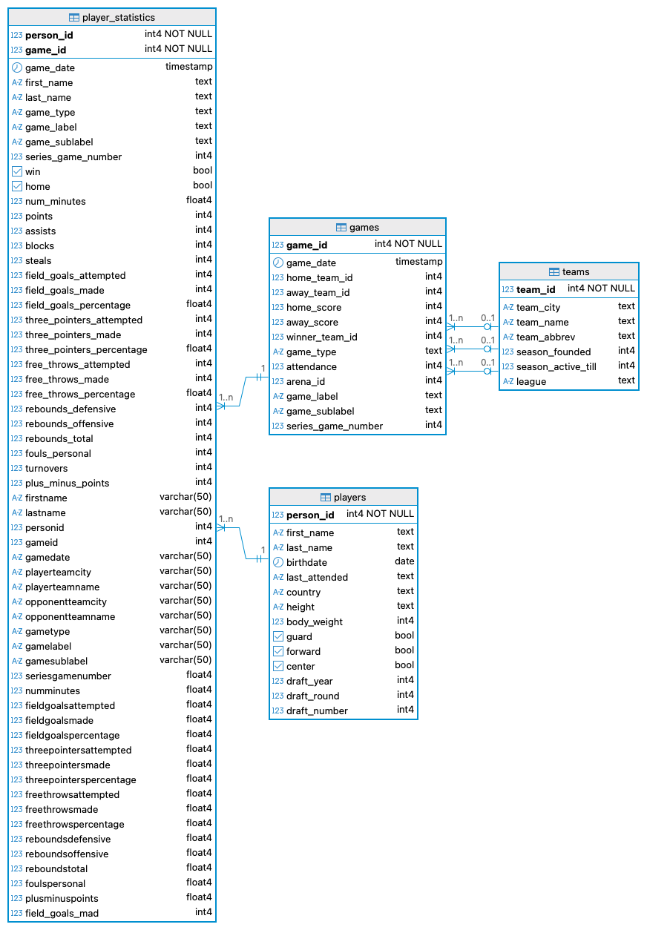
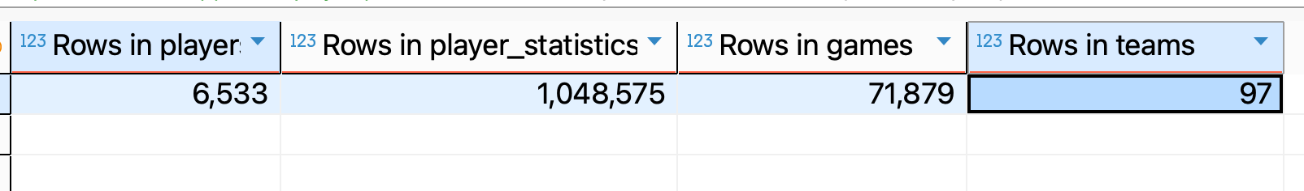

Slide 4
LIMIT number of results
In large tables like player_statistics, a plain SELECT * can be slow and unnecessary.
When we just want to peek at the data, we can use LIMIT to restrict the number of rows.
This is useful when exploring a new table or debugging queries.
Using LIMIT also makes EXPLAIN ANALYZE faster and easier to read.
-- Without LIMIT: reads the whole table
EXPLAIN ANALYZE
SELECT *
FROM nba.player_statistics;
-- With LIMIT: just sample 10 rows
EXPLAIN ANALYZE
SELECT *
FROM nba.player_statistics
LIMIT 10;

Slide 5
Use JOINS instead of subqueries
We have learned subqueries can be very useful to retrieve data from tables that are not connected
However, they are not very efficient as the system needs to access each table individually and work on them as sets
If the tables are connected, give preference to JOINs, as they access one table and, through the connected attribute, access the second table.

Slide 6
Use JOINS instead of subqueries
--JOIN X SUBQUERY
-- Get the city of the home team for each game
--Using a SUBQUERY
EXPLAIN ANALYZE SELECT game_id,
(SELECT team_city
FROM nba.teams t
WHERE t.team_id = g.home_team_id) AS home_city
FROM nba.games g;
--Using a JOIN: notice how team_id is treated like an index that facilitates data identification
EXPLAIN ANALYZE SELECT game_id,
team_city "Home city"
FROM games g
JOIN teams t
ON (t.team_id = g.home_team_id);

Slide 7
PREPARE
The PREPARE statement allows to define a query once and reuse it multiple times with different parameters
The database server parses, plans, and optimizes the query once when the PREPARE statement is executed.
A placeholder ($1, $2, etc.) is used for parameters in the query.
For queries that are executed frequently or in loops, using PREPARE significantly reduces execution time.

Slide 8
PREPARE
--PREPARE
-- Prepare a parameterised query: (int, text)
PREPARE get_player_stats (int, text) AS
SELECT ps.game_id,
ps.points,
ps.assists,
ps.rebounds_total,
g.game_date,
g.game_type
FROM player_statistics ps
JOIN games g USING (game_id)
WHERE ps.person_id = $1 -- player id
AND g.game_type = $2; -- for example, 'Regular Season', 'Playoffs'

Slide 9
SPECIFIC QUERIES
Avoid SELECT * in production queries:
Unnecessary I/O (reads columns we do not use).
Queries break if later columns are added or removed.
Instead, select only the columns you need and filter rows early.
--Avoid SELECT *
SELECT *
FROM nba.player_statistics
WHERE points > 30;
--Prefer specifying the columns
SELECT person_id,
game_id,
points,
assists,
rebounds_total
FROM nba.player_statistics
WHERE points > 30;

Slide 10
Transactions
Transactions group SQL statements into atomic, consistent, isolated, and durable operations.
Transactions encapsulate multiple steps into a single, all-or-nothing operation.
The intermediate states between the steps are not visible to other concurrent transactions.
Therefore, if anything goes wrong, it prevents the transaction from completing, then none of the steps affect the database at all.

Slide 11
Transactions
BEGIN: A transaction always starts with the BEGIN keyword, indicating to the DB a transaction is starting, with multiple in it.
COMMIT: keyword used so the changes made by the transaction are effective. All the queries after the COMMIT persist in the database.
ROLLBACK: Allows us to undo changes promoted by the queries. If the system crashes during the transaction after writing thousands of queries, we are able to rollback.

Slide 12
Transactions
In an NBA context, imagine correcting stats for a game:
Remove the old stats rows for a game.
Insert corrected stats.
Update the game’s final score.
Either all of these changes should happen, or none.

Slide 13
Transactions
-- 1. Start the transaction
BEGIN;
-- 2. Delete old statistics
DELETE FROM player_statistics
WHERE game_id = 22400677;
-- 3. Insert corrected statistics
INSERT INTO player_statistics (
person_id, game_id, game_date,
points, assists, rebounds_total
)
VALUES
(201939, 22400677, '2025-11-01', 32, 8, 5),
(2544, 22400677, '2025-11-01', 28, 7, 9);
-- 4. Update the game final score
UPDATE games
SET home_score = 110,
away_score = 105
WHERE game_id = 22400677;

Slide 14
ACID Properties
Transactions follow the principals of ACID properties:
Atomicity – all or nothing. Example: Adjusting stats for a game involves deleting old stats and inserting corrected ones. If the insertion fails, none of the deletions or updates should be kept.
Consistency – valid state. Example: After a game is updated, home_score and away_score must still equal the sum of individual players’ points, and foreign keys (home_team_id, away_team_id) must still reference valid teams.
Isolation – independent execution. Example: Two analysts might be editing stats for different games at the same time. Each transaction should not see the other’s intermediate, half-finished changes.
Durability – permanent changes. Example: Once corrected stats for the NBA finals are committed, the database guarantees that those changes will survive a server restart or power failure.

Slide 15
Trigger
A trigger specifies that the database should automatically execute a particular function whenever a certain type of operation is performed.
Triggers can be performed on tables, being executed before or after an INSERT, UPDATE or DELETE statement.

Slide 16
Trigger
A trigger in the NBA schema can automatically:
Update a team’s total wins/losses when a game is inserted.
Maintain a summary table with each player’s career totals whenever player_statistics changes.
We can define triggers as row-level (per row) or statement-level (per statement).

Slide 17
Trigger
Triggers can be:
Row-Level Trigger ensures immediate updates for individual inserts.
Statement-Level Trigger ensures consistency after bulk operations, catching any discrepancies caused by operations like manual changes or bulk inserts.
The differences between the two kinds are how many times the trigger is invoked and at what time. For example, if you issue an UPDATE statement that modifies 20 rows, the row-level trigger will be invoked 20 times, while the statement-level trigger will be invoked only once.

Slide 18
Trigger
Use ROW-LEVEL trigger when:
Your logic depends on the individual values of each inserted/updated row
You need to modify the row before it is stored
You want consistent per-row behaviour
Use STATEMENT-LEVEL trigger when:
Your logic applies to the whole table, not individual rows
You are working with bulk operations (INSERT…SELECT, UPDATE many rows)
You want to avoid running the same logic hundreds or thousands of times

Slide 19
Common Table Expression (CTE)
Temporary result set that can be referenced within a SELECT, INSERT, UPDATE, or DELETE statement.
It provides a way to break down complex queries into more manageable and readable parts.
Good for multi-step calculations. In our NBA example: finding top scorers per team, or average points per game.

Slide 20
Common Table Expression (CTE)
Even though CTEs and Views are used to reorganise and reuse data, they have different purposes.
A CTE is temporary and only exists for the duration of that query.
Views are persistent and can be queried like regular tables.

